Slide 1






HELLO THERE
Welcome to JOB PORTAL
29-OCT-2024

Slide 2

PROJECT
OUTLINE
ANGULAR
SPRING BOOT
JOB PORTAL WITH ANGULAR AND SPRING BOOT
NATIVE ANDROID
FLUTTER
KEY DISCUSSION POINTS
MD NAJMUL ISLAM | ISDB 59-ROUND JEE STUDENT

Slide 3
ABOUT THE
JOB PORTAL
Here we make a very simple JOB PORTAL using ANGULAR
for the front end and the back, we use SPRING BOOT
PROJECT FEATURES
USER:
1. Can view the job,
2. Appy for the existing job
EMPLOYER:
1. Post a Job
2. View the job applications
3. Edit and update Both
ADMIN:
1. Post a Job
2. View the job applications
3. Edit and update and delete Both
USING SPIRING BOOT AND ANGULAR
MD NAJMUL ISLAM | ISDB 59-ROUND JEE STUDENT

Slide 4

FOR SECURITY
WE USE JWT SECURITY AUTH
FOR BACKEND AND FRONTEND ANGULAR BUILT-IN SECURITY
Web Token (JWT) representing the user's identity and adds it to the response. Sending JWT Token to Frontend: The backend responds to the Angular frontend's authentication request with an HTTP response
MD NAJMUL ISLAM | ISDB 59-ROUND JEE STUDENT

Slide 5


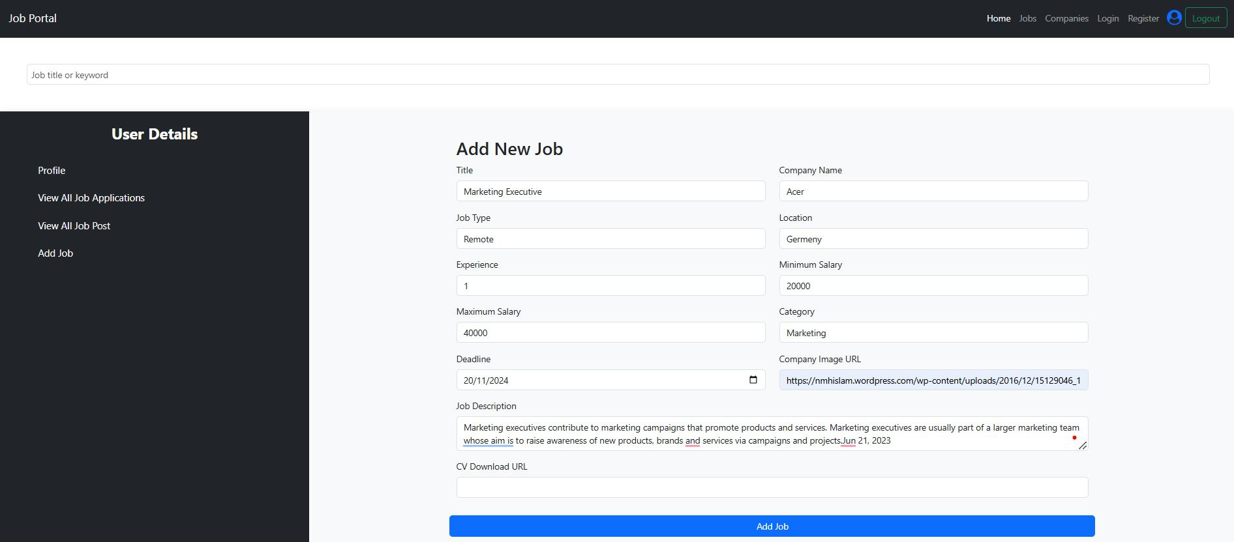
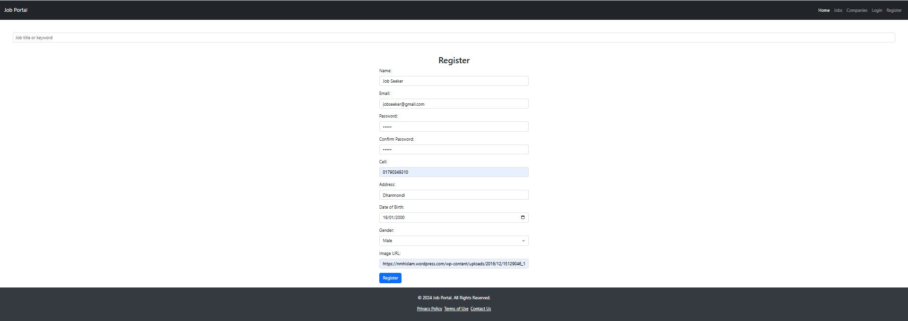
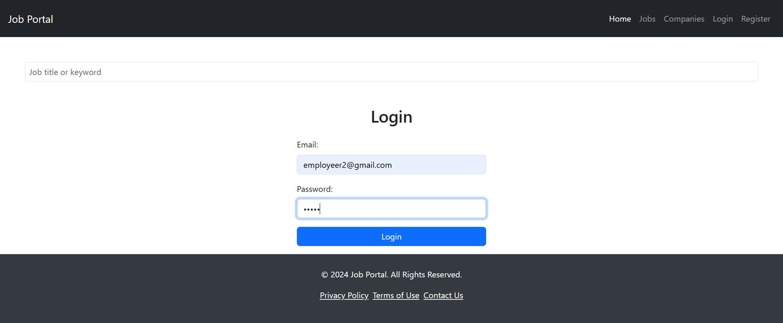
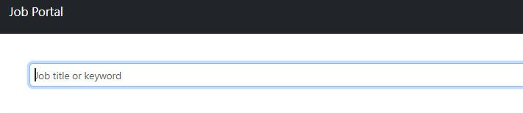
HERE I ADDED SOME SCREENSHOT

Slide 6

WHAT I USE FOR WEB
WHAT I WANT TO USE FOR MOBILE
ANGULAR
SPRING BOOT
ANDROID
FLUTTER
We use spring boot for backend, we make @Entity, @Service, @Repository and @RestController.
We use angular for our front-end. There we make component, Router, Module, Guard, Service and other thinks
We will deply it using API using by RETRO-FIT Services on the native platform.
We will deploy also in the cross platform that basically extend native android SDK and all other platform : IOS, Windows and Linux by their own technology

Slide 7

Thanks!
Md. Najmul Islam
IsDB-BISEW (IT SCHOLARSHIP PROGRAMME)
ROUND-59
BATCH JEE-59
ID: 1281305
TSP: CCSL

Slide 8

THANKS AGAIN
Code is like humor. When you have to explain it, it’s bad.
CORY HOUSE

